Slide 1
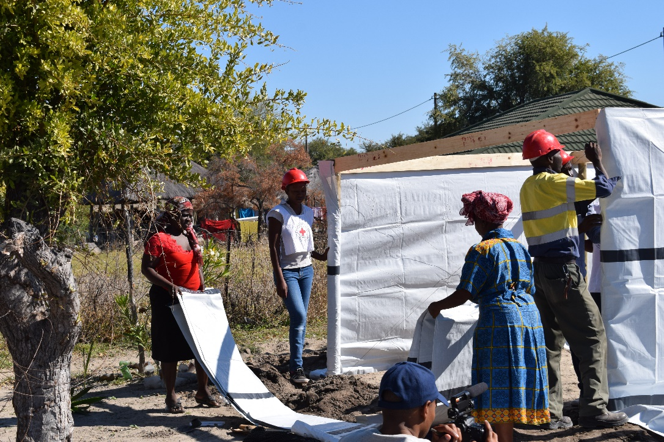
Southern Africa DM Network ADMAG Meeting Nairobi – 5-7 September 2018
BRCS volunteers assisting floods affected population with emergency shelter ©BRCS

Slide 2
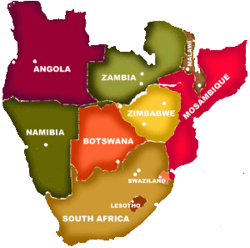
Setting the scene
10 National Societies
9 DM Departments
4 Newly recruited DM (2018)
1 Acting DM
Most of the NS DM departments are composed of 1 staff
Main Hazards/Risks: Floods, Cyclones, Drought, Food Insecurity, Population Movement and Epidemics
Small to Medium scale disasters / Seasonal hazards

Slide 3
Southern Africa DM Network a Long Silence Southern Africa Partnership of Red Cross Societies Sub Committees (Health, NSD, DM) Shared Leadership Group on Cyclical Disasters and Chronic Food Insecurity 7 PNS and ICRC are supporting DM components DM meeting in October DM Network ToR Priorities and Action Plan for 2019

Slide 4
Objectives and alignment with ADMAG a Setup an active DM Network and online Communication Platform based on EA Cluster model for all Movement Partners (NS, PNS, ICRC, IFRC) Promote and support FBF and Micro-insurance initiatives (1 BC) SMCC – Movement Contingency Plans EP, MCA, Movement Coordination Platform… Cross-border Preparedness / Migration Network Cash Preparedness RDRT Training and Roster update (Surge Optimization) Food Security Preparedness

Slide 5
Methodology Mapping of resources and gaps NS Peer to Peer exchange Keep Trend Analysis updated Improve DREF process, compliance and reporting Inter-cluster exchange and communication Clarify Roles and Responsibilities

Slide 6
Challenges and adaptation a Visibility and communication Funding Southern Africa is not dead - We have ideas - We are innovative Re-establish a living and active DM Network Communicate on NS DM activities and impact Be realistic with our financial and human capacities Bring back interest on Southern Africa

Slide 7
Need ADMAG Support Communication Visibility HR Support Advocate Support Fundraising

Slide 8
Questions?

